Slide 1

Comparative Evaluation of Tabu Search and Genetic Algorithm for the Travelling Salesman Problem
Jahid Hasan Shamim

Slide 2





The Travelling Salesman Problem
The Challenge
NP-Hard Classification
Real-World Applications
Find the shortest tour visiting each city exactly once and returning to the start.
Exact solutions scale exponentially, making them infeasible for larger instances (Garey & Johnson, 1979).
Logistics & transport routing
Manufacturing scheduling
Network optimisation
Motivation: Exact solvers become infeasible for medium/large instances, requiring metaheuristic approaches.

Slide 3

Study Aim & Methodology
Research Objective
Evaluation Criteria
Experimentally compare the performance of Tabu Search (TS) and Genetic Algorithm (GA) on TSP instances of increasing size under controlled conditions.
Solution quality
Runtime efficiency
Robustness
Scalability
Statistical significance

Slide 4


Experimental Design
1
2
Dataset
Controlled Testing
50 synthetic cities with 2D Cartesian coordinates. Instance sizes: 10, 20, 30, 40, 50 cities.
30 independent runs per configuration with identical city subsets for both algorithms.
3
Implementation
Fixed random seeds, unified Python experimental pipeline, automatic CSV export of results.

Slide 5


Algorithm Comparison
Tabu Search
Genetic Algorithm
Memory-based local search
Population-based evolutionary method
2-opt neighbourhood exploration
Population = 120, Generations = 500
Tabu list prevents cycling
Tournament selection
Aspiration criterion for global best
Ordered crossover with swap mutation
Strong exploitation
Strong global exploration

Slide 6
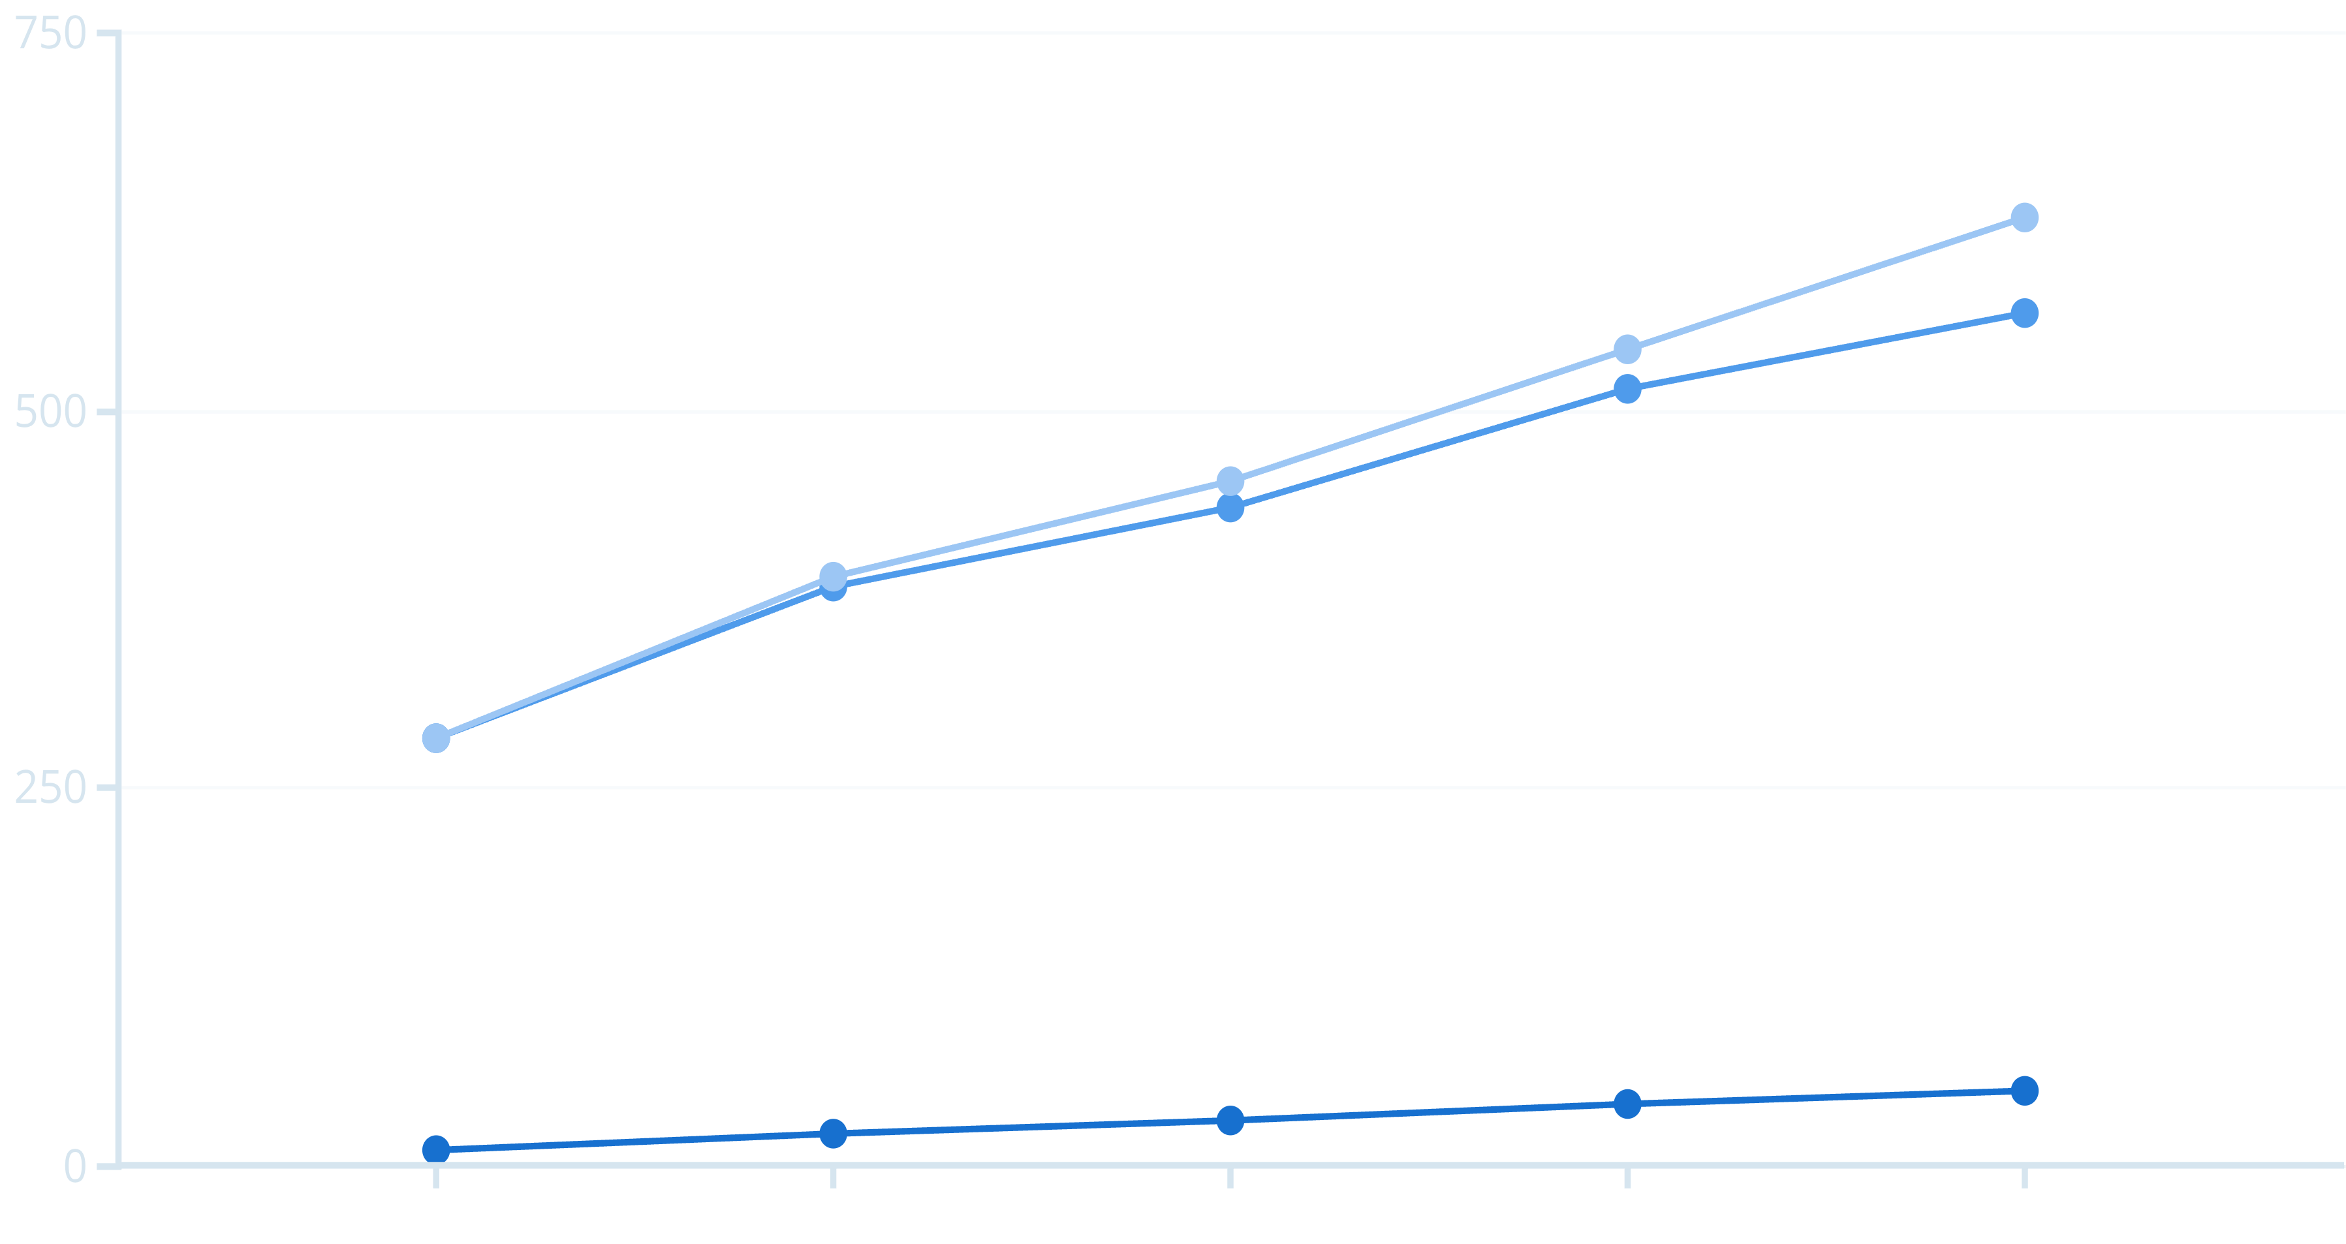
Solution Quality: Tour Length Performance
Mean tour length comparison across problem sizes reveals significant performance differences.
Cities
Tabu Search
Genetic Algorithm
Key Finding: Both algorithms perform similarly at 10–20 cities. After 30 cities, the performance gap increases rapidly. At 50 cities, Tabu Search produces tours ~11% shorter than Genetic Algorithm.

Slide 7

Runtime Efficiency: Speed Comparison
1.51s
28.39s
19×
Genetic Algorithm
Tabu Search
Speed Advantage
Runtime at 50 cities
Runtime at 50 cities
GA is approximately 19 times faster than TS
GA Efficiency
Fixed population size and predictable computational cost enable rapid execution.
TS Intensity
Intensive neighbourhood search and memory management operations increase runtime significantly.

Slide 8
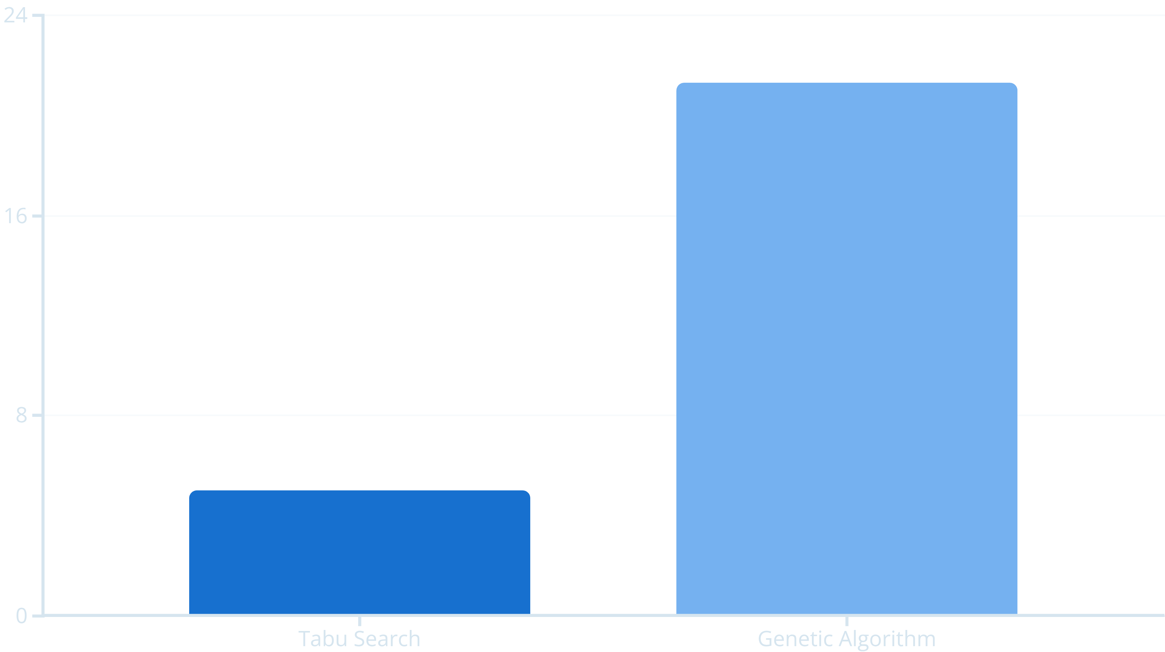
Robustness & Consistency Analysis
Standard deviation measurements reveal algorithm stability across multiple runs.
Tabu Search: Highly stable and repeatable results with minimal variance.
Genetic Algorithm: Higher variance due to stochastic mutation and crossover operations.

Slide 9
Statistical Significance & Summary
Cities
TS Mean
GA Mean
TS Time (s)
GA Time (s)
10
283.84
283.84
9.20
0.46
20
383.88
389.67
14.07
0.66
30
435.27
452.80
18.75
0.88
40
513.18
540.52
24.22
1.18
50
565.23
627.42
28.39
1.51
Statistical Testing: Paired two-tailed t-test reveals p < 0.01 at 50 cities. Tabu Search superiority in solution quality is statistically significant.

Slide 10



Conclusions & Recommendations
Tabu Search Strengths
Genetic Algorithm Strengths
Best solution quality
Fast execution (19× faster)
Highest robustness
Predictable runtime
Statistically significant advantage
Good for time-critical applications
Trade-off: High computational cost
Trade-off: Lower solution quality & higher variance
Real-Time Systems
Offline Planning
Dynamic Systems
Use Genetic Algorithm for speed-critical applications
Use Tabu Search for optimal solution quality
Use Genetic Algorithm for multi-objective scenarios
Ethical Compliance: Fully synthetic dataset, GDPR compliant, open-source software only, academic use of AI tools.

Slide 11
Reference • OpenAI used for background image generation and grammar refinement.

